Slide 1


Info5990 Professional Practice in IT Lecture 06 A & B
(Only) An introduction
to Project Management
You will learn a lot more on IT Project Management course

Slide 2
By the end of this lecture you will be able to:
Appreciate the need for project management in Information Technology
Determine a work breakdown structure
Describe some common approaches to estimating the effort required for IT projects
Understand tools such as network diagrams, critical path,etc
Understand what is meant by ‘crashing’ a project
Case studies

Slide 3
Quick Update Quiz 1
60 minutes / 10 marks - ONE ATTEMPT
Multiple choice
60 questions / 1 + minutes per question
Open book / use your slides, only 1st 6 weeks lectures
questions to test your critical and analytical skills !
1 attempt to answer questions – otherwise it is too easy
Random questions – cannot work your mates answer !
Open from October 4th@ 11.59pm till 11th October @ 11.59pm
Do it any time, but make sure you complete in 1 go
Cannot have 280 students claiming internet was down - they get 0%.
No extensions ! - Don’t just try to see if it is working !
No reset’s if you are not in lecture or have not read the instructions – students receive 0
Notes:
Read agenda
Ask questions as we go.

Slide 4


Group assignment
Questions ?

Slide 5

I.T Project management
Who wants a career in Tech or I.T management ?

Slide 6

I.T Project Managers
Depending on experience
Can earn between $70K - $200K Full time
Hourly rate on contract rates between $80/hr - $200hr
Or $600 - $1500 per day !
Anyone interested ? – then listen !

Slide 7
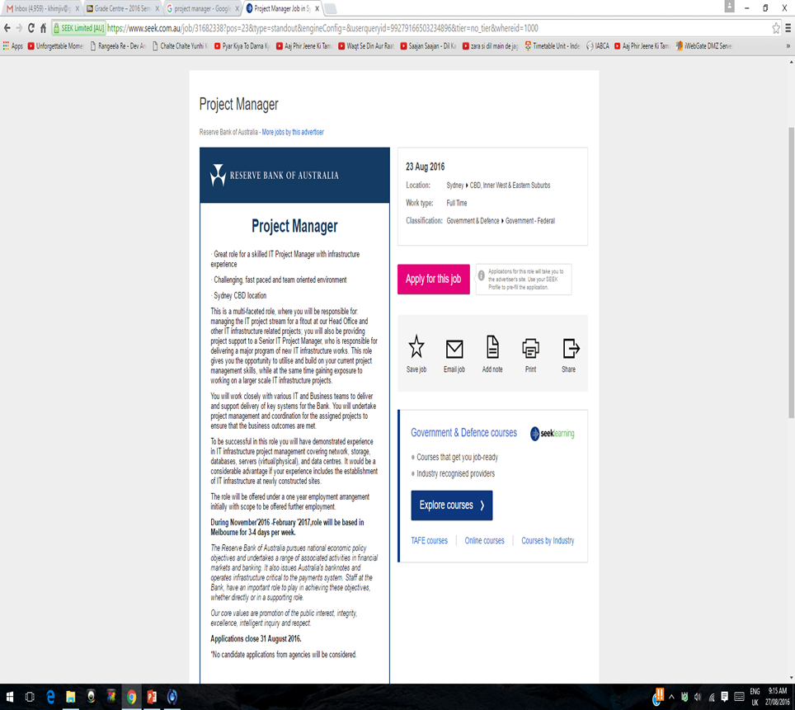
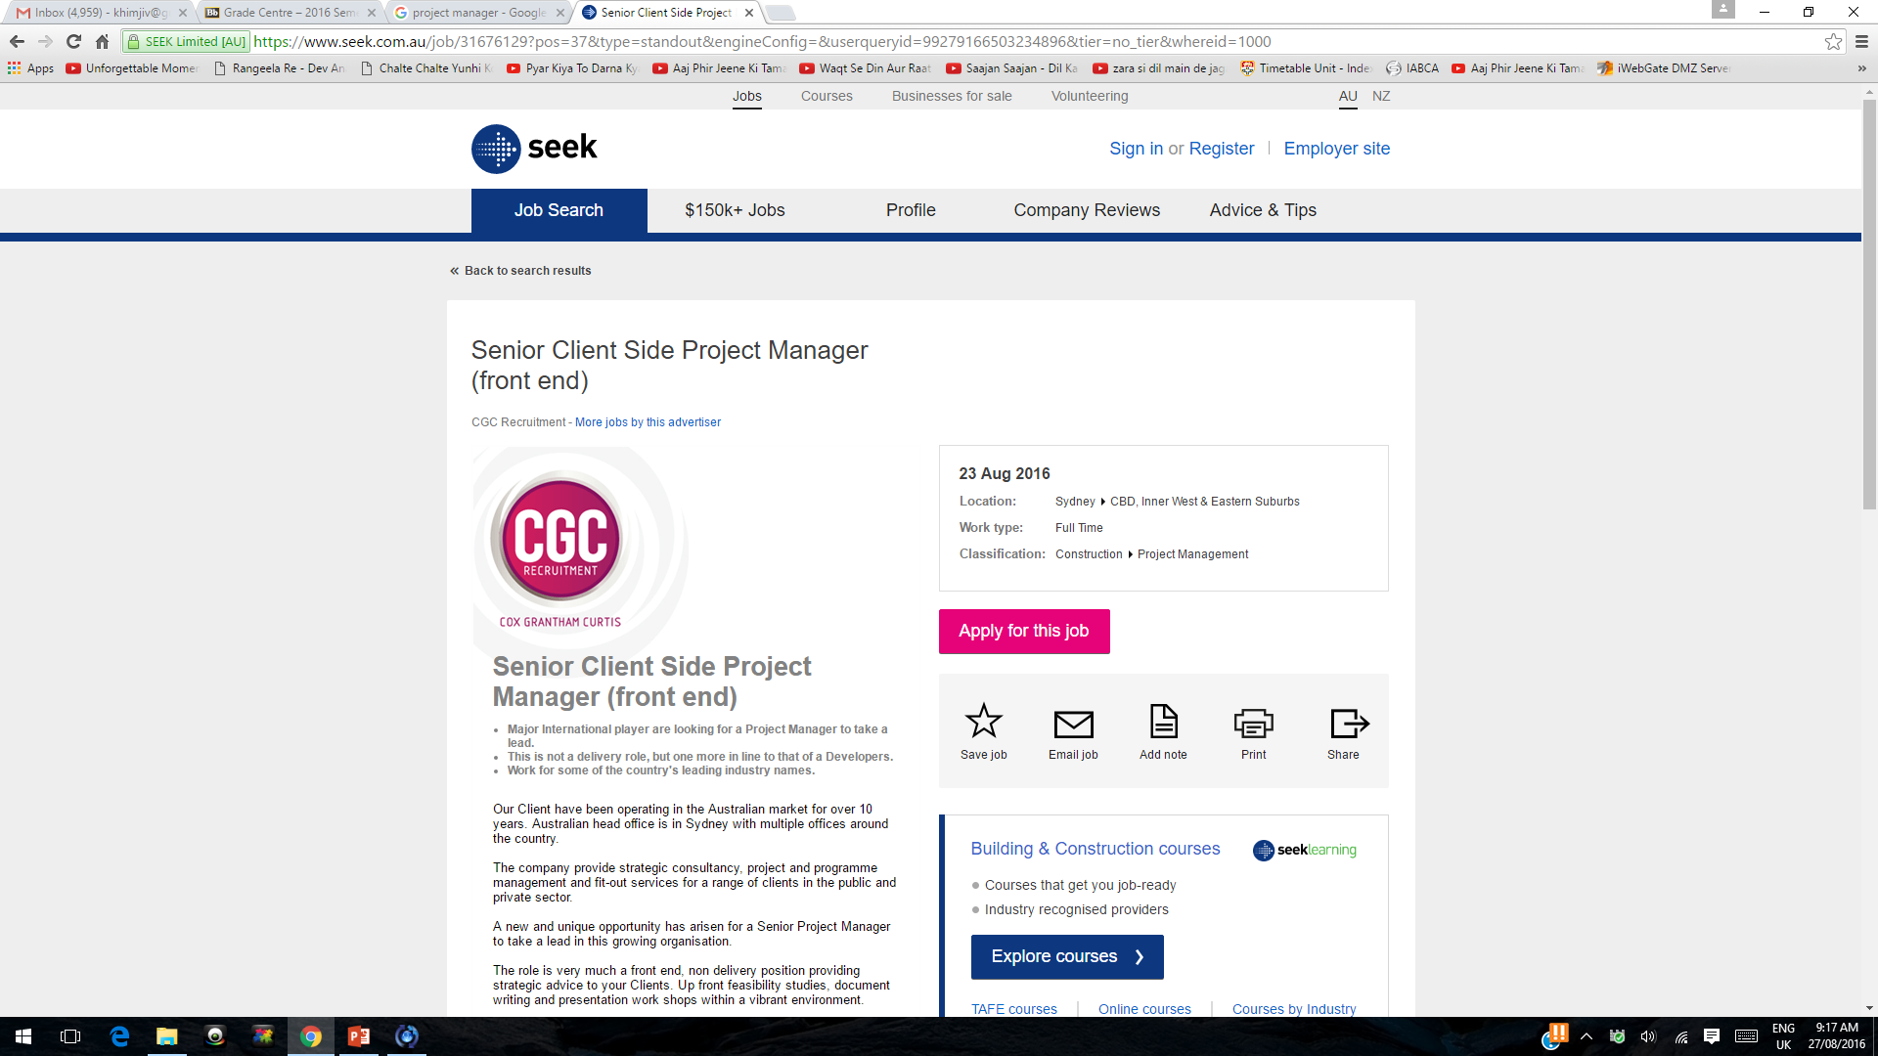

Slide 8
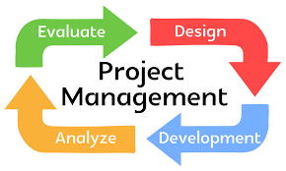
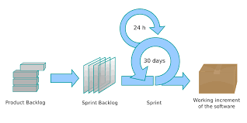
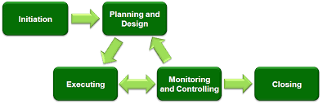
Basic PM
Scrum /Agile
More detailed coverage in the IT PM course

Slide 9

First a case study:
Thoughts for you Group Assignment !

Slide 10

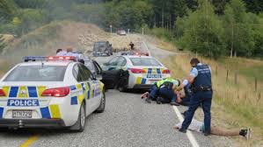
The NZ Police ‘INCIS’* project – 1 Gauld, Goldfinch and Dale, 2006
Does not matter if it is from 1990’s ?
1993 Initial estimate $NZ30.1 Million (3 phases) Annual cost of crime to the nation $4.8 Billion Expected benefits $NZ5.3 Billion over its lifetime
1995 New user requirements
1996 Change in operating system from OS/2 to NT, change in network protocol from token ring to Ethernet, TCP/IP
Old case study ??
*Integrated National Crime Investigation System

Slide 11
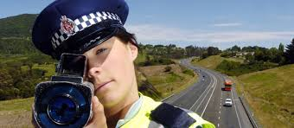
The NZ Police ‘INCIS’* project – 2 Gauld, Goldfinch and Dale, 2006
1997 Project 12 months behind, project manager resigns
1998 Revised estimate $NZ118 Million (4 times original estimate)
1999 March: Phase 1 complete, cost estimate now $NZ126.7 Million

Slide 12

The NZ Police ‘INCIS’* project – 3 Gauld, Goldfinch and Dale, 2006
1999 August: IBM the hardware supplier pulled out
2000 Project cancelled at a cost of over $NZ100 Million and with only phase one completed.

Slide 13
What do you think went wrong?
Who was to blame?
_________________________
_________________________
_________________________
_________________________

Slide 14


Question
Any projects you have been involved in that look like this one ?

Slide 15

An introduction to project management
What is a project?
“A project is a temporary endeavour undertaken to create a unique product or service over a period of defined time.”
A project has a clearly defined
beginning and end.

Slide 16

Standish Group's Chaos Report https://www.projectsmart.co.uk/white-papers/chaos-report.pdf
“71 percent of software projects will be challenged of fail”.
These are grim words, and the situation has not improved since then.

Slide 17

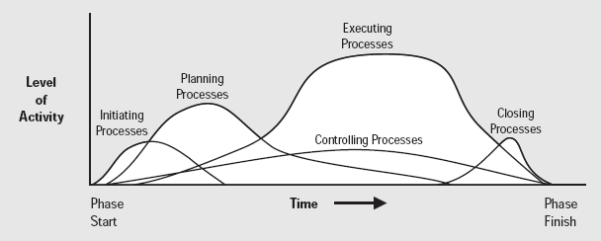
Project management challenges at every stage

Slide 18
The cost of project failure across the European Union was €142 billion
“A study in project failure” by John McManus and Trevor Wood-Harper
214 projects studied Average duration of projects 26 months Average budget €6 million
Number of projects completed | 163 | 76.2%
Number of projects cancelled | 51 | 23.8%
Off those cancelled : Number of projects over-run) (schedule and/or cost) | 69* | 32.4%
* 37 of these projects were over 18 months late and more than €4 million over budget

Slide 19
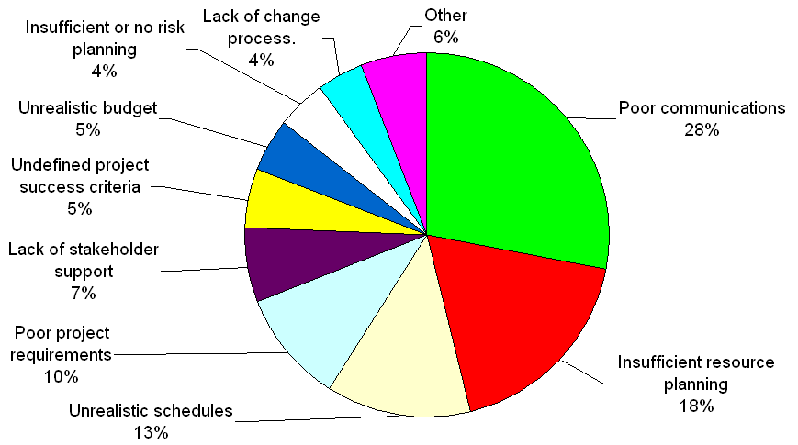
Reported Reasons for Project IT Failure Computing Technology Industry Association (CTIA) Survey of 1,000 respondents, 2007 Do you think the figure is any different in 2017

Slide 20
Question
Why poor communications ?

Slide 21
Four most common reasons
Incomplete project requirements (10%)
Unrealistic schedules (13%)
Insufficient resource planning (18%)
Poor communications (28%)
These are four areas are central to the practice of
“PROJECT MANAGEMENT”

Slide 22
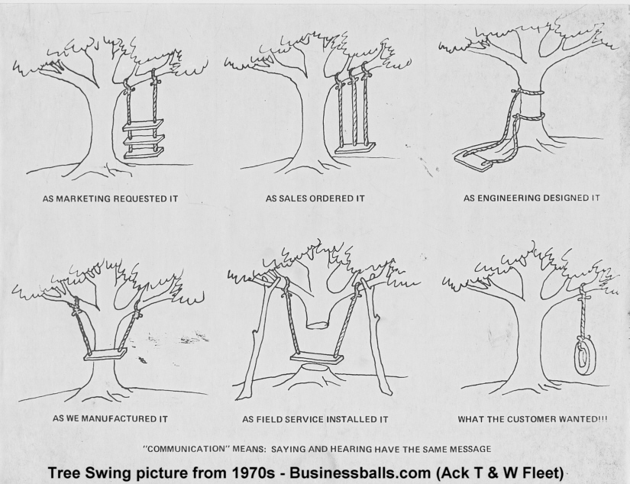
Does this happen in 2019 ?

Slide 23


The “Triple Constraint”
The aim of the project manager is to
have the project completed on time and within budget, ...
... whilst at the same time satisfying the quality of work required.
The project manager is bound by the “Triple Constraint”:
Scope
Time
Cost $

Slide 24
Question
Which might be the predominant element in your group project ?

Slide 25
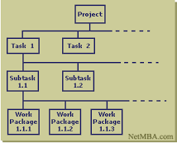


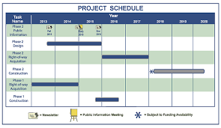
Key Planning principle: four steps
Determine work breakdown structure
Estimate amount of effort required
Determine dependencies between activities
Devise project schedule

Slide 26
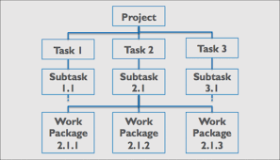
Determining the Work Breakdown Structure (WBS) (still a useful tool)
“A work breakdown structure is a deliverable-oriented grouping of project elements that organizes and defines the total scope of the project”
Project Management Book of Knowledge; Project Management Institute; 1996

Slide 27
Elements of work breakdown structure
Deliverable
A unit of output that is to be delivered
Activity
A major work category.
Usually lasts no less than one day and no longer than 30 days.
Task
Small unit of work that makes up an activity

Slide 28

The granularity problem
How much detail is enough?
Does this breakdown have enough detail?
Why not?
 |  | Week
Task | Hours | 5 | 6 | 7 | 8 | 9 | 10 | 11 | 12
Source tools | 1 | <->
Build software API | 8 |  | <--- | ---- | ---- | ---- | --->
Test API | 2 |  |  |  |  |  |  | <->

Slide 29
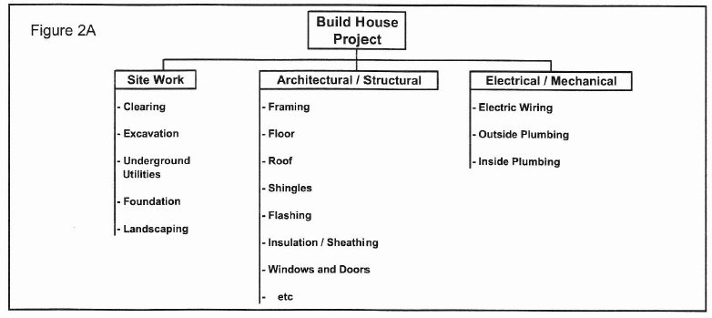
Which view is right? This …

Slide 30
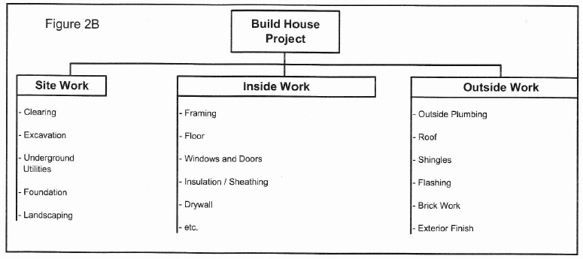
Or this …
Which breakdown is correct?
Are they both correct?
Which is better?

Slide 31

Determining dependencies
Which task(s) must be completed before this activity or task can begin?

Slide 32
The resulting network
D
G
B
E
H
K
A
F
C
I
J
Is the network unique or are there multiple correct solutions?

Slide 33
Work breakdown, time estimates dependencies
Task ID | Task Description | Duration (in weeks) | Predecessors
A | Initiate project | 0 | --
B | R & D product design | 6 | A
C | Plan market research | 2 | A
D | Routing (engineering) | 3 | B
E | Build prototype | 5 | B
F | Prepare brochure | 3 | B
G | Prepare cost estimates | 2 | D
H | Product testing | 3 | E
I | Market survey | 4 | C, F
J | Pricing and demand forecast | 2 | I
K | Final report | 2 | G, H, J

Slide 34
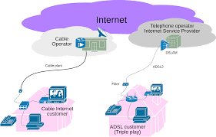

Case Study of CPM
SiteLight Project 1998 at Telstra

Slide 35
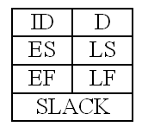
Activity parameters
Activity identifier
Duration
Earliest start
Latest start
Earliest finish = Earliest start + Duration
Latest finish = Latest start + Duration
Slack = Latest - Earliest

Slide 36
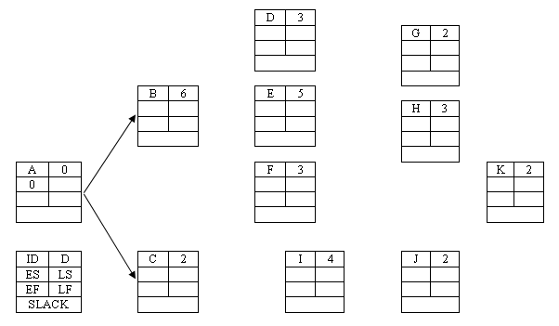
Calculating duration of project (1)
Add lines to represent dependencies
Determine earliest start times for activities B, C, D, E
Determine earliest finish times for activities A, B, C, D, E

Slide 37
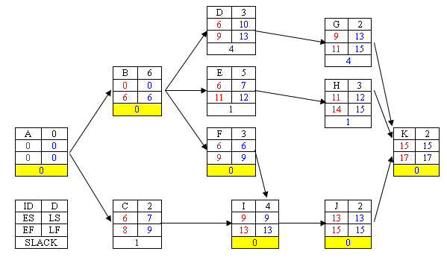
The critical path (zero slack)
0
2
7

Slide 38
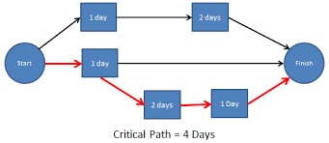
CPM – why is it important
In 1957 the Critical Path Method (CPM) was developed at DuPont Chemicals to assist with project management.

Slide 39
Question
Why is slack in a project important ?

Slide 40

Cost of Crashing a Project (1)
Costs more at the end of a project to cancel than at the start !
Source:blog.flydealfare.com

Slide 41


INFO5990 Professional Practice in IT Lecture 06B
Time Management
How big, how long, how much effort?
Project estimation methods
The REALLY tricky part of project management

Slide 42
By the end of this lecture you will be able to:
Appreciate several approaches for estimating project size and effort
Explain their relative advantages and disadvantages
Apply one or more of these approaches to your case study

Slide 43

Basic terminology
You will learn a lot more on IT Project Management course

Slide 44
Five steps in project estimation
Determine the SIZE of the project
software metrics: lines of code, function points
Determine the EFFORT required
Person hours, days, weeks or months
Decide on the RESOURCES needed
e.g. how many engineers or programmers
Calculate the DURATION
e.g. 20 person-hours, 3 people: ∴ DURATION = 20 / 3 = 6.3 hours
Calculate the COST
e.g. 20 person-hours at $70 per hour: ∴ COST = $1,400

Slide 45
Six approaches to project estimation
Expert judgement – will cover this
Sum of the parts – will cover this – will cover this
Estimation by analogy
Component matrix (not common)
Algorithmic cost models (not common)
Function point analysis (not common)

Slide 46
Choosing estimation methods
Which is easiest to apply?
Which can be applied earliest in the system development life cycle (SDLC)?
What assumptions does each make?
Do I have enough historic data?
Will I need to re-calibrate for tool, developer experience, environment, etc.
How many times will I use this method? Can I improve my estimates over time?

Slide 47

1. Expert judgement
An expert in software development as well as in the application domain makes an estimate based on previous experience of similar projects.

Slide 48
Expert judgement – pros & cons
Advantages:
Relatively cheap estimation method.
Takes relatively little time and effort
Can be applied early in the development cycle
Can be successful if experts have direct experience of similar systems
Disadvantages:
Rather subjective
Depends on experience and judgment
Cannot be used if no suitable experts available
Assumes experts have dealt with similar systems
Assumes they all have reliable data available

Slide 49
2. Sum of the parts
Makes use of work breakdown structure
Total effort estimate is the sum of estimates for individual tasks
Appropriate level of detail (granularity) is important
too much detail takes too much time and introduces more error
insufficient detail means more difficult to assign tasks (see work breakdown structure, Lec 6A)
Must make allowance for overheads and tasks such as testing and documentation

Slide 50
The hard part of project estimation
Determining
Work breakdown
Durations
Dependencies
Task ID | Task Description | Duration (in weeks) | Predecessors
A | Initiate project | 0 | --
B | R & D product design | 6 | A
C | Plan market research | 2 | A
D | Routing (engineering) | 3 | B
E | Build prototype | 5 | B
F | Prepare brochure | 3 | B
G | Prepare cost estimates | 2 | D
H | Product testing | 3 | E
I | Market survey | 4 | C, F
J | Pricing and demand forecast | 2 | I
K | Final report | 2 | G, H, J

Slide 51
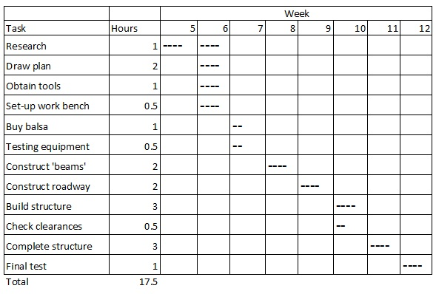
Sum of the parts example

Slide 52

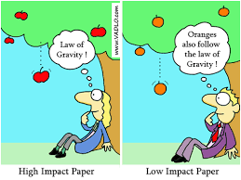
3. Estimation by analogy*
Compare current project to similar project(s) already undertaken
Estimate how many times bigger or smaller the current project is compared with others
*See for example, Martin Shepperd, Chris Schofield and Barbara Kitchenham, Effort Estimation Using Analogy, Proceedings of ICSE-18, IEEE, 1996

Slide 53
Using analogy – pros & cons
Advantages:
Systematic, fairly fast
OK if sufficient historical data available
Can be applied early in the development cycle
Disadvantages:
Have to determine set of characteristics suitable for classifying systems
Requires a database containing systematically maintained historical size cost data.
Cannot be used if no comparable projects have ever been tackled, or if no suitable historical data is available

Slide 54
A case study
Khimji
Because we learnt a lot last time !

Slide 55

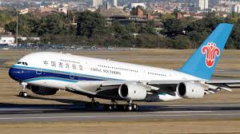


You’re proposal has won the design contract for the A380 In-flight Entertainment system!

Slide 56

Your proposal out of 10 others has been awarded the multi-million $ order !
Others were rejected because they did not have enough information,
low on technology innovativeness, skill of team, etc
What next !

Slide 57
What are the requirements!

Slide 58
How long do you have !
Remember
Determine the SIZE of the project
software metrics: lines of code, function points
Determine the EFFORT required
Person hours, days, weeks or months
Decide on the RESOURCES needed
e.g. how many engineers or programmers
Calculate the DURATION
e.g. 20 person-hours, 3 people: ∴ DURATION = 20 / 3 = 6.3 hours
Calculate the COST
e.g. 20 person-hours at $70 per hour: ∴ COST = $1,400

Slide 59


You are under tight time frames
Client has asked for earlier delivery !
What do you do ?!

Slide 60
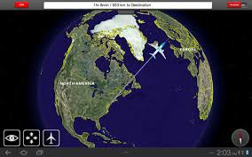

In Final testing
The Flight route system does not work as planned
what do you do ?

Slide 61

How do you test the success !

Slide 62
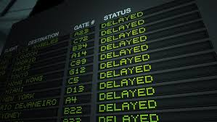
Why did the A380 get delayed ?

Slide 63

Mid-term break next week

Slide 64

Just the start of PM
Remember this is a taster of PM
So much more to cover next Lecture
Thank you !

